Slide 1
Reinforcement Learning for Inventory Optimization
Larry Snyder
Professor, Industrial and Systems Engineering
Director, I-DISC
RL for Operations Summer Bootcamp
Northwestern University, Aug. 18, 2022

Slide 2
The Newsvendor Problem as a Multi-Armed Bandit
Part 1

Slide 3
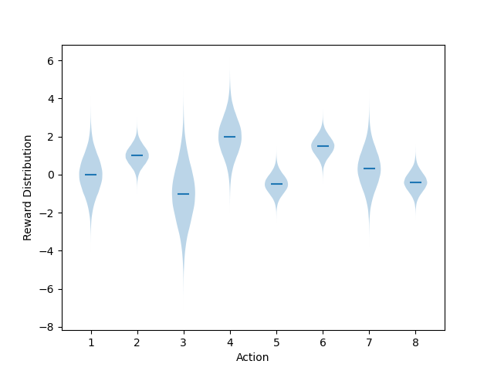
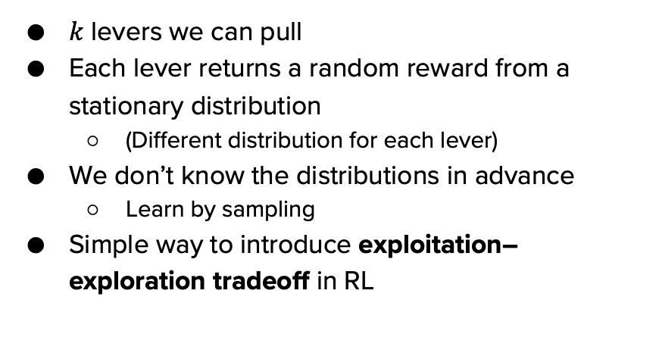
Multi-armed bandits (MAB)
$k$ levers we can pull
Each lever returns a random reward from a stationary distribution
(Different distribution for each lever)
We don’t know the distributions in advance
Learn by sampling
Simple way to introduce exploitation–exploration tradeoff in RL

Slide 4
MAB: Choosing an action
If we knew the reward distributions, it’s simple:
But we don’t
So:
Sometimes exploit: choose (what we think is) the best action
Sometimes explore: choose a non-best action to improve our estimate
Always choose the action with the largest $𝔼$[reward]

Slide 5
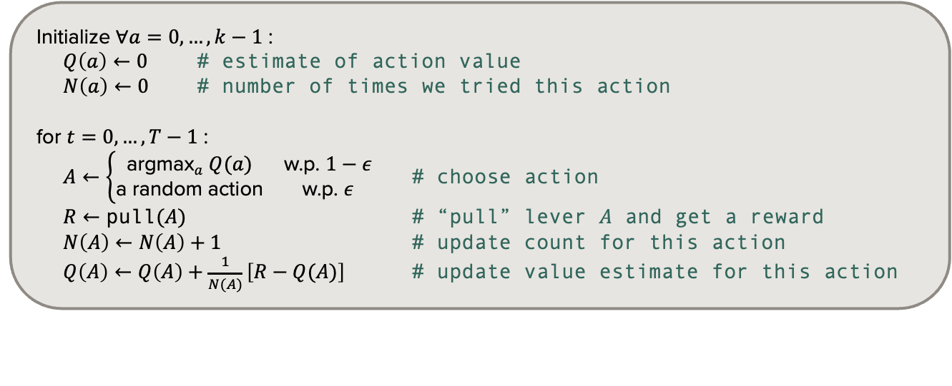
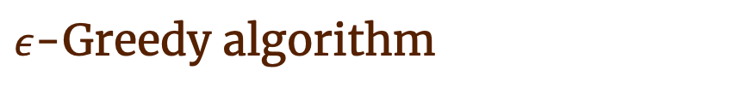
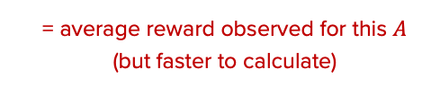
$ε$-Greedy algorithm
Initialize $∀a=0,…,k−1$ :
$Q\left(a\right)←0$ # estimate of action value
$N\left(a\right)←0$ # number of times we tried this action
for $t=0,…,T−1$ :
$A←\left\{\begin{matrix}{\text{argmax}}_{a} Q(a) & \text{w}\text{.}\text{p}\text{. }1−ε \\ \text{a} \text{random} \text{action} & \text{w}\text{.}\text{p}\text{. }ε\end{matrix}\right.$ # choose action
$R←\text{pull}(A)$ # “pull” lever $A$ and get a reward
$N\left(A\right)←N\left(A\right)+1$ # update count for this action
$Q\left(A\right)←Q\left(A\right)+\frac{1}{N(A)}\left[R−Q(A)\right]$ # update value estimate for this action
= average reward observed for this $A$
(but faster to calculate)
(Adapted from Sutton and Barto 2018)

Slide 6
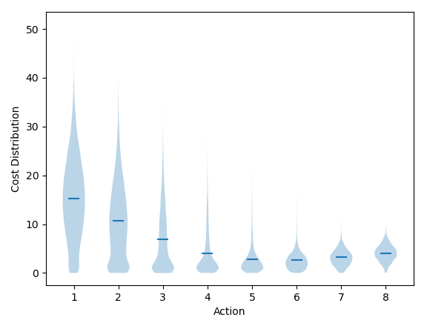
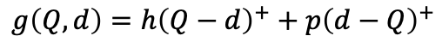
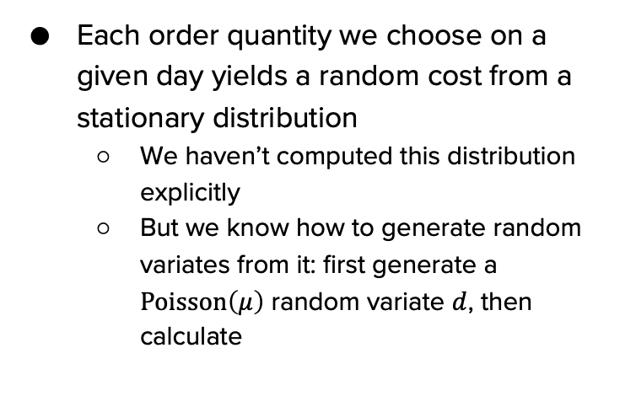
The newsvendor problem as an MAB
Each order quantity we choose on a given day yields a random cost from a stationary distribution
We haven’t computed this distribution explicitly
But we know how to generate random variates from it: first generate a $\text{Poisson}\left(μ\right)$ random variate $d$, then calculate
$$g\left(Q,d\right)=h{\left(Q−d\right)}^{+}+p{\left(d−Q\right)}^{+}$$

Slide 7
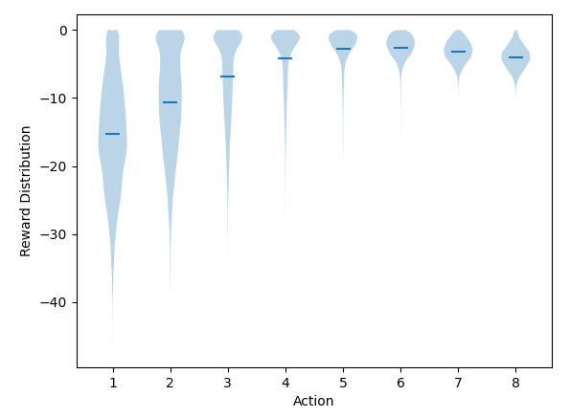
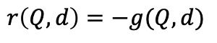
The newsvendor problem as an MAB
To stay consistent with MAB/RL terminology, we’ll use rewards instead of costs:
Then it’s straightforward to model the newsvendor problem as an MAB
$$r\left(Q,d\right)=−g(Q,d)$$

Slide 8
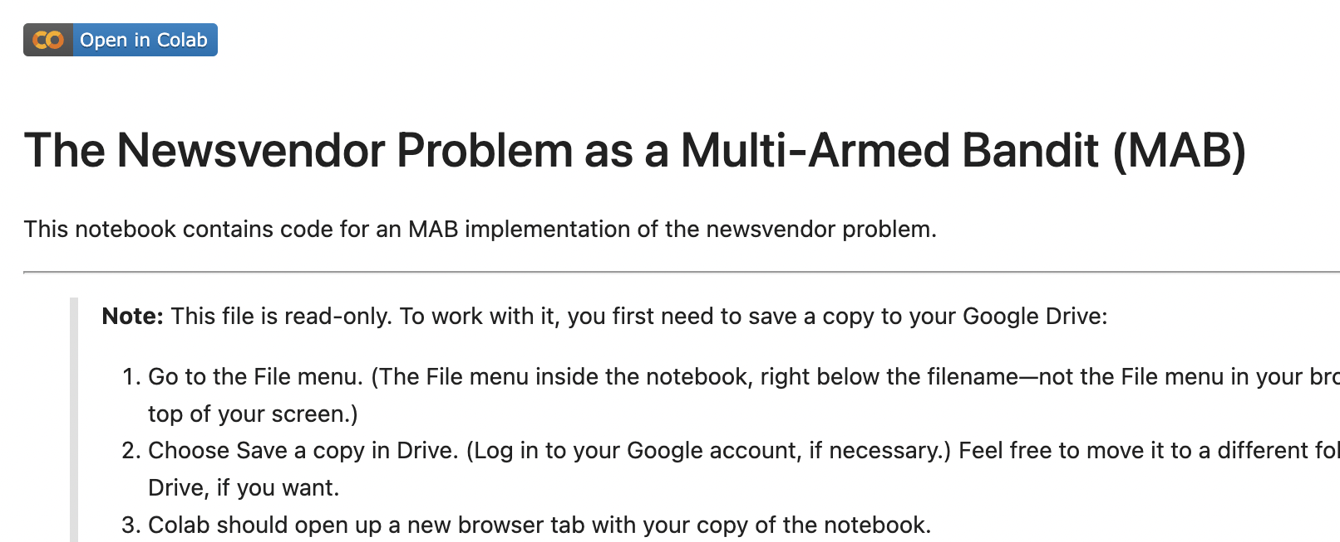
Coding time!
Go to github.com/LarrySnyder/RLforInventory
Click notebooks
Click 1: NV as MAB.ipynb
Click the “Open in Colab” button:
Follow the directions in the notebook to make your own copy
Work through the notebook at your own pace

Slide 9
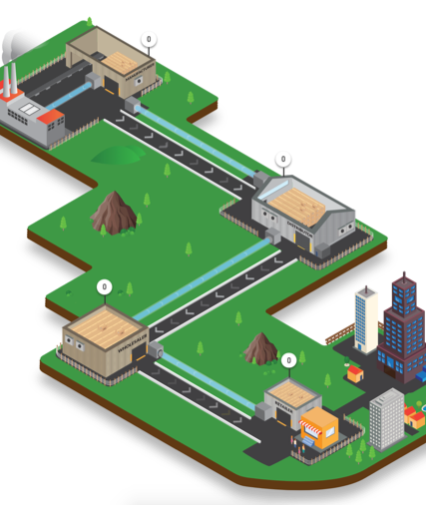

Questions?
larry.snyder@lehigh.edu
https://coral.ise.lehigh.edu/larry/
Supported in part by NSF grants NSF:CCF:1618717, NSF:CMMI:1663256, NSF:CCF:1740796, and XSEDE:DDM180004.

